Slide 1
Bayesian Classifiers

Slide 2
When the relationship between the attribute set and the class variable is non deterministic
i.e. the class label of a test record cannot be predicted with certainty even though its attribute set is identical to some of the training examples.
This situation may arise because of noisy data or the presence of certain cofounding factors that affect classification but are not included in the analysis.
For example for developing heart disease, if we consider only two attributes diet (healthy/non healthy) and exercise frequency is not sufficient as there are other factors such as heredity, excessive smoking and alcohol abuse.

Slide 3
So to model probabilistic relationship between attribute set and class variable we use Bayesian classifiers.

Slide 4
Bayesian classifiers
Bayesian classifiers are statistical classifiers
They can predict class membership probabilities such as the probability that a given tuple belongs to a particular class.
Bayesian classification is based on Bayes’ theorem.

Slide 5
Example
There are two machines for creating an item
Machines work at different rate
Items are marked with the machine number that created it so we know that particular item came from which machine
Total items produced by both machines have few defective items also.
What is the probability of machine 2 producing a defective item?
If we select any item produced by machine 2, what is the probability that it is defective?

Slide 6
Bayes Theorem
Machine 1: 30 items/hour
Machine 2: 20 items/hour
Out of all produced items:
1% are defective
Out of all defective items:
50% came from machine1 and 50% came from machine2
Question:
What is the probability that an item produced by machine2 is defective?
Probability of any given item coming from machine1: P(Mach1) = 30/50= 0.6
Probability of any given item coming from machine2: P(Mach2) = 20/50= 0.4
P(Defect) = 1%
P(Mach1|Defect)=50%
P(Mach2|Defect)=50%
P(Defect|Mach2)=?

Slide 7
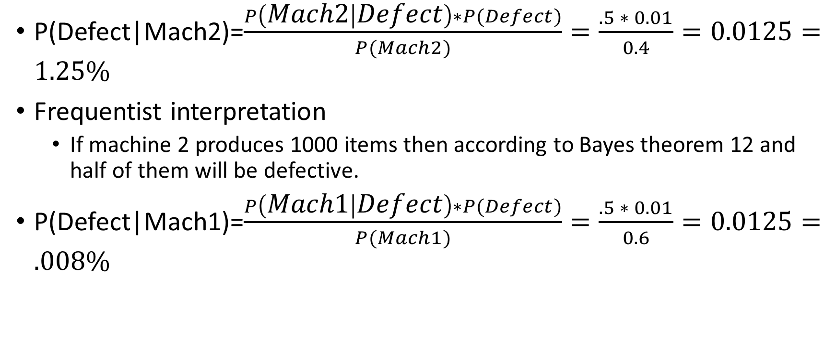
Bayes Theorem

Slide 8
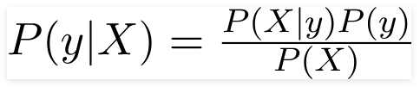
Naïve Bayes Classifier
It is a probabilistic machine learning model
Naïve Bayes Classifier is also called as simple Bayesian classifier
The crux of the classifier is based on the Bayes theorem

Slide 9
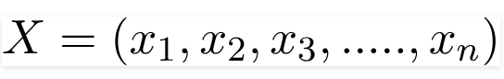
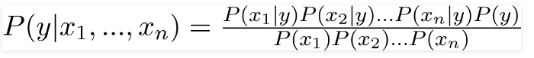
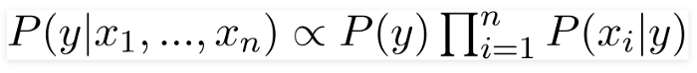
How Bayes Theorem is used here
Example
Y- will buy a new product
X- features like age and salary
Now, we can obtain the values for each by looking at the dataset and substitute them into the equation.
For all entries in the dataset, the denominator does not change, it remain static.
Therefore, the denominator can be removed and a proportionality can be introduced.
Age EstimatedSalary Purchased
19 19000 0
35 20000 1
26 43000 0
32 57000 1
19 76000 0

Slide 10
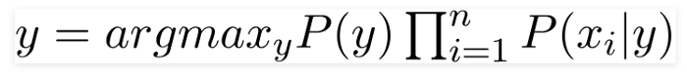
In our case, the class variable(y) has only two outcomes, yes or no.
There could be cases where the classification could be multivariate.
Therefore, we need to find the class y with maximum probability
Using the above function, we can obtain the class, given the predictors.

Slide 11
Bayes Theorem
Bayes’ theorem is named after Thomas Bayes
A statistical principle for combining prior knowledge of classes with new evidence gathered from data.
Let X be a data tuple.
In Bayesian terms, X is considered “evidence.”
It is described by measurements made on a set of n attributes.
Let H be some hypothesis such as that the data tuple X belongs to a specified class C.
For classification problems, we want to determine P(H|X)
the probability that the hypothesis H holds given the “evidence” or observed data tuple X.
In other words, we are looking for the probability that tuple X belongs to class C, given that we know the attribute description of X.

Slide 12
Posteriori probability
P(H|X) is the posterior probability, or a posteriori probability, of H conditioned on X.
For example, suppose our world of data tuples is confined to customers described by the attributes age and income, respectively, and that X is a 35-year-old customer with an income of $40,000.
Suppose that H is the hypothesis that our customer will buy a computer.
Then P(H|X) reflects the probability that customer X will buy a computer given that we know the customer’s age and income.

Slide 13
Prior Probability
In contrast, P(H) is the prior probability, or a priori probability, of H.
For our example, this is the probability that any given customer will buy a computer, regardless of age, income, or any other information, for that matter.
The posterior probability, P(H|X), is based on more information (e.g., customer information) than the prior probability, P(H), which is independent of X

Slide 14
Other probabilities
Similarly, P(X|H) is the posterior probability of X conditioned on H.
That is, it is the probability that a customer, X, is 35 years old and earns $40,000, given that we know the customer will buy a computer.
P(X) is the prior probability of X.
Using our example, it is the probability that a person from our set of customers is 35 years old and earns $40,000.
How are these probabilities estimated?”
P(H), P(X|H), and P(X) may be estimated from the given data
Bayes’ theorem is useful in that it provides a way of calculating the posterior probability, P(H|X), from P(H), P(X|H), and P(X).

Slide 15
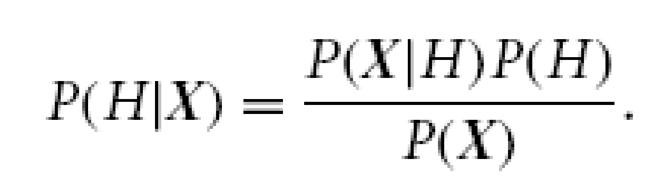
Bayes’ Theorem

Slide 16
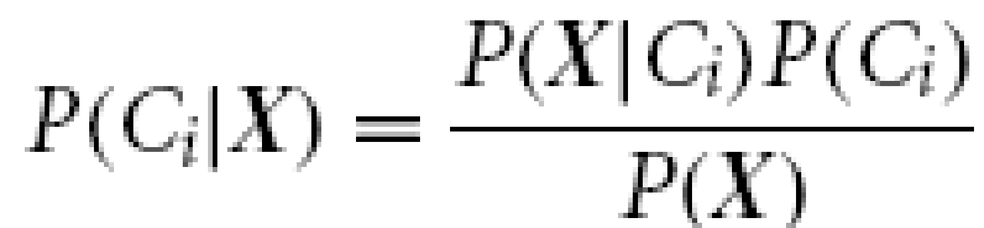
Working of Na¨ıve Bayesian Classifier
1. Input: Let D be a training set of tuples and their associated class labels. As usual, each tuple is represented by an n-dimensional attribute vector, X = (x1, x2, : : : , xn), depicting n measurements made on the tuple from n attributes, respectively, A1, A2, : : : , An
Suppose that there are m classes, C1, C2, : : : , Cm.
2. Given a tuple, X, the classifier will predict that X belongs to the class having the highest posterior probability, conditioned on X.
That is, the na¨ıve Bayesian classifier predicts that tuple X belongs to the class Ci if and only if
P(Ci|X) > P(Cj|X) for 1≤ j ≤ m, j ≠ i.
The class Ci for which P.Ci jX/ is maximized is called the maximum posteriori hypothesis.
By Bayes Theorem

Slide 17
Working of Na¨ıve Bayesian Classifier
3. As P(X) is constant for all classes, only P(X|Ci)P(Ci) needs to be maximized.
If the class prior probabilities are not known, then it is commonly assumed that the classes are equally likely,
that is, P(C1) = P(C2)=…= P(Cm), and we would therefore maximize P(X|Ci). Otherwise, we maximize P(X|Ci)P(Ci).
Note that the class prior probabilities may be estimated by P(Ci)=|C_{i,D}|/|D|, where |C_{i,D}| is the number of training tuples of class Ci in D.

Slide 18
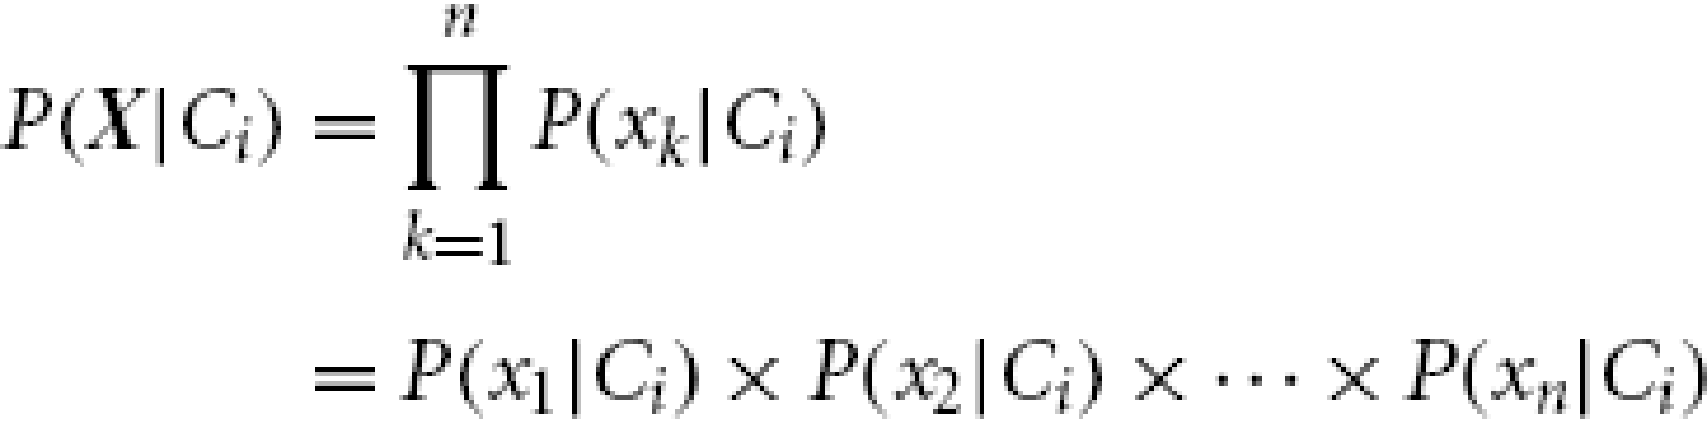
Working of Na¨ıve Bayesian Classifier
4. Given data sets with many attributes, it would be extremely computationally expensive to compute P(X|Ci)
To reduce computation in evaluating P(X|Ci), the na¨ıve assumption of class-conditional independence is made.
This presumes that the attributes’ values are conditionally independent of one another, given the class label of the tuple (i.e., that there are no dependence relationships among the attributes). Thus,

Slide 19
Working of Na¨ıve Bayesian Classifier
How to estimate the probabilities P(x1|Ci), P(x2|Ci),…, P(xn|Ci)
We can easily estimate the probabilities P(x1|Ci), P(x2|Ci),…, P(xn|Ci) from the training tuples.
Here x_{k} refers to the value of attribute A_{k} for tuple X.
For each attribute, we look at whether the attribute is categorical or continuous-valued.
For instance, to compute P(X|Ci), we consider the following:
i) If Ak is categorical, then P(xk|Ci) is the number of tuples of class Ci in D having the value xk for Ak, divided by |C_{i,D}|, the number of tuples of class Ci in D.
ii) If Ak is continuous-valued, then we need to do a bit more work, but it can be done.

Slide 20
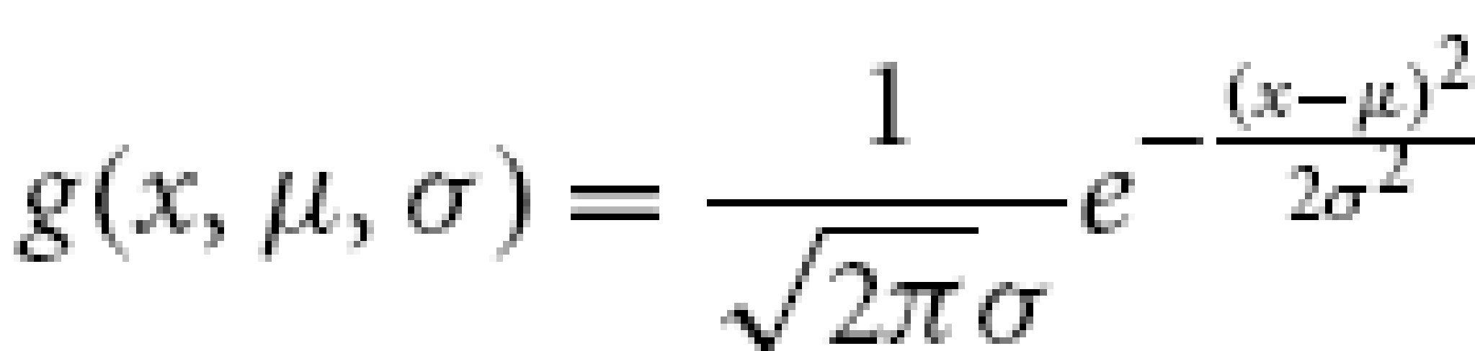

Working of Na¨ıve Bayesian Classifier
if there is single independent var and we assume its distribution as normal distribution
A continuous-valued attribute is typically assumed to have a Gaussian distribution with a mean and standard deviation, defined by
So that
Where μ_{Ci} and σ_{Ci} are mean and standard deviation of the values of attribute Ak for training tuples of class Ci .

Slide 21
Working of Na¨ıve Bayesian Classifier
Example:
let X = (35,$40,000), where A1 and A2 are the attributes age and income, respectively.
Let the class label attribute be buys computer
The associated class label for X is yes (i.e., buys computer = yes)
Let’s suppose that age has not been discretized and therefore exists as a continuous-valued attribute.
Suppose that from the training set, we find that customers in D who buy a computer are 38±12 years of age.
In other words, for attribute age and this class, we have μ= 38 years and σ=12.
We can plug these quantities, along with x1= 35 for our tuple X, into previous Eq. to estimate P(age= 35|buys computer = yes).

Slide 22
Working of Na¨ıve Bayesian Classifier
5. To predict the class label of X, P(X|Ci)P(Ci) is evaluated for each class Ci .
The classifier predicts that the class label of tuple X is the class Ci if and only if
P(X|Ci)P(Ci) > P(X|Cj)P(Cj) for 1≤ j ≤ m, j ≠ i.

Slide 23
Full Bayes Classifier
Calculate Class Priors
Calculate the prior probabilities of each class (play tennis and not play tennis) based on the frequency of each class in the training data.
Estimate Likelihoods
This approach is particularly useful when dealing with continuous features that are correlated.
Parameter Estimation
For each class
��
C
j
​
, you estimate the parameters of the multivariate normal distribution, which include the mean vector
��
μ
j
​
and the covariance matrix
��
Σ
j
​
.
The mean vector
��
μ
j
​
contains the means of each feature within class
��
C
j
​
, and the covariance matrix
��
Σ
j
​
describes the relationship between features in terms of their variances and covariances

Slide 24
Probability Density Function (PDF):
Probability Density Function (PDF):
Once you have estimated the parameters for each class, you can compute the probability density function (PDF) of the multivariate normal distribution for a given instance
�
x within each class
��
C
j
​
.
The PDF of a multivariate normal distribution is given by:
�(� ∣ ��,��)=1(2�)�∣��∣exp⁡(−12(�−��)���−1(�−��))
f(x∣μ
j
​
,Σ
j
​
)=
(2π)
k
∣Σ
j
​
∣
​
1
​
exp(−
2
1
​
(x−μ
j
​
)
T
Σ
j
−1
​
(x−μ
j
​
))
where
�
k is the number of features,
∣��∣
∣Σ
j
​
∣ is the determinant of the covariance matrix, and
��−1
Σ
j
−1
​
is the inverse of the covariance matrix.

Slide 25
Classification:
To classify a new instance
�
x, you calculate the posterior probability
�(�� ∣ �)
P(C
j
​
∣x) for each class
��
C
j
​
using Bayes' theorem.
The likelihood
�(� ∣ ��)
P(x∣C
j
​
) is given by the PDF of the multivariate normal distribution for class
��
C
j
​
, and the prior
�(��)
P(C
j
​
) can be estimated from the training data.
You then select the class with the highest posterior probability as the predicted class for the instance
�
x.

Slide 26
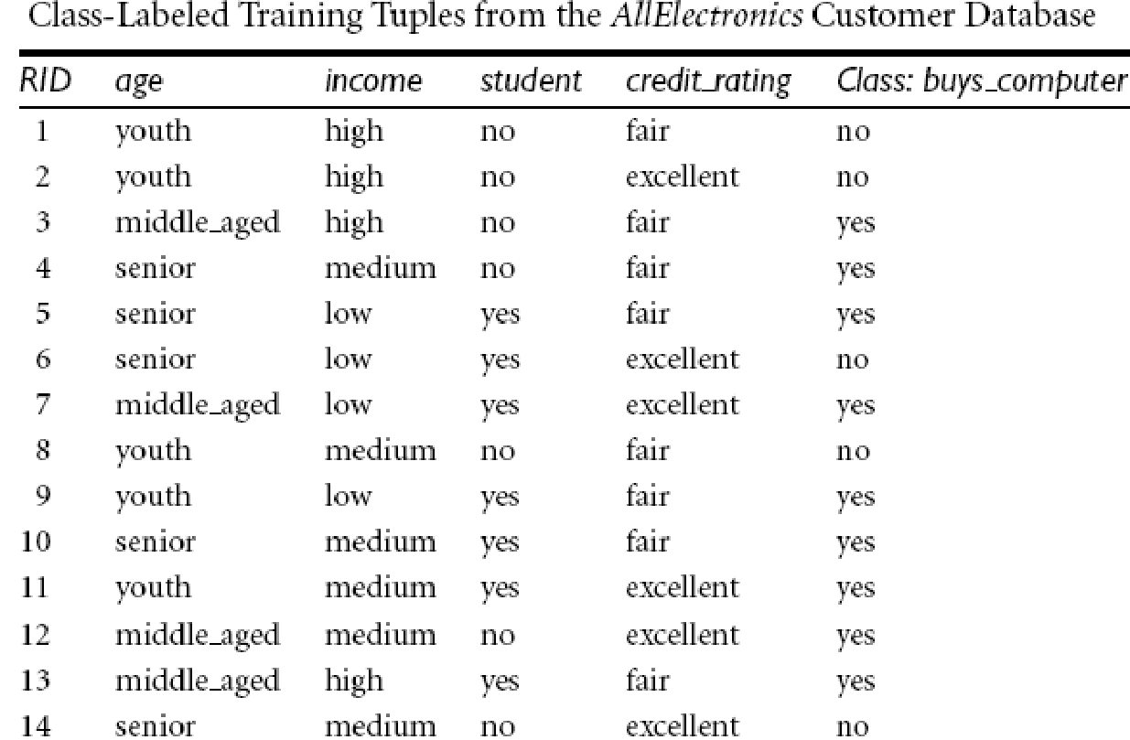
Predicting a class label using na¨ıve Bayesian classification: Example

Slide 27
Predicting a class label using na¨ıve Bayesian classification: Example
Let C1 correspond to the class buys computer = yes and C2 correspond to buys computer = no.
The tuple we wish to classify is X = (age = youth, income = medium, student = yes, credit rating = fair)
We need to maximize P(X|Ci)P(Ci), for i = 1, 2.
P(Ci), the prior probability of each class, can be computed based on the training tuples:
P(buys computer = yes) = 9/14 = 0.643
P(buys computer = no) = 5/14 = 0.357

Slide 28
Predicting a class label using na¨ıve Bayesian classification: Example
To compute P(X|Ci), for i = 1, 2, we compute the following conditional probabilities:
P(age = youth | buys computer = yes) = 2/9 = 0.222
P(age = youth | buys computer = no) = 3/5 = 0.600
P(income = medium | buys computer = yes) = 4/9 = 0.444
P(income = medium | buys computer = no) = 2/5 = 0.400
P(student = yes | buys computer = yes) = 6/9 = 0.667
P(student = yes | buys computer = no) = 1/5 = 0.200
P(credit rating = fair | buys computer = yes) = 6/9 = 0.667
P(credit rating = fair | buys computer = no) = 2/5 = 0.400

Slide 29
Using these probabilities, we obtain
P(X|buys computer = yes) = P(age = youth | buys computer = yes)
x P(income = medium | buys computer = yes)
x P(student = yes | buys computer = yes)
x P(credit rating = fair | buys computer = yes)
= 0.222x0.444x0.667x0.667 = 0.044.
Similarly, P(X|buys computer = no) = 0.600x.400x.200x.400 = 0.019
To find the class, Ci , that maximizes P(X|Ci)P(Ci), we compute
P(X|buys computer = yes)P(buys computer = yes) = 0.044 x 0.643 = 0.028
P(X|buys computer = no)P(buys computer = no) = 0.019 x 0.357 = 0.007
Therefore, the na¨ıve Bayesian classifier predicts buys computer = yes for tuple X.

Slide 30
What if I encounter probability values of zero?”
what happens if we should end up with a probability value of zero for some P(xk|Ci)?
For example if there are no training tuples representing students for the class buys computer = no, resulting in P(student = yes|buys computer = no) = 0?
Plugging this zero value into previous Eq. would return a zero probability for P(X|Ci), even though, without the zero probability, we may have ended up with a high probability, suggesting that X belonged to class Ci !
A zero probability cancels the effects of all the other (posteriori) probabilities (on Ci) involved in the product.
If we have, say, q counts to which we each add one, then we must remember to add q to the corresponding denominator used in the probability calculation.

Slide 31
What if I encounter probability values of zero?”...
simple trick to avoid this problem
We can assume that our training database,
D, is so large that adding one to each count that we need would only make a negligible difference in the estimated probability value, yet would conveniently avoid the case of probability values of zero.
This technique for probability estimation is known as the Laplacian correction or Laplace estimator, named after Pierre Laplace, a French mathematician who lived from 1749 to 1827.

Slide 32
What if I encounter probability values of zero?” Example: Using the Laplacian correction to avoid computing probability values of zero
Suppose that for the class buys computer = yes in some training database, D, containing 1000 tuples, we have 0 tuples with income = low, 990 tuples with income = medium, and 10 tuples with income = high.
The probabilities of these events, without the Laplacian correction, are 0, 0.990 (from 990/1000), and 0.010 (from 10/1000), respectively.
Using the Laplacian correction for the three quantities, we pretend that we have 1 more tuple for each income-value pair.
In this way, we instead obtain the following probabilities (rounded up to three decimal places):
1/1003 = 0.001, 991/1003 = 0.988, and 11/1003 = 0.011, respectively.
The “corrected” probability estimates are close to their “uncorrected” counterparts, yet the zero probability value is avoided.

Slide 33
Naïve Bayes Classifier
Why Naïve?
Bayes Theorem has some Independence Assumptions
That are often times not correct therefore its kind of naïve to assume that its correct
e.g. Features have to be independent
In this example Age and salary are not independent
i.e. the effect of an attribute value on a given class is independent of the values of the other attributes.
This assumption is called classconditional independence.
It is made to simplify the computations involved and, in this sense, is considered “naïve.”
Salary
Derives
New Data Point
Walks
Age

Slide 34
Step 1
P(Walks|X) where X 🡪features of new data points
Posterior probability of somebody being a person that walks to work given that it is placed in the position where we are placing the new observation for our dataset
What is the likelihood of that new observation representing a person who walks to work?

Slide 35
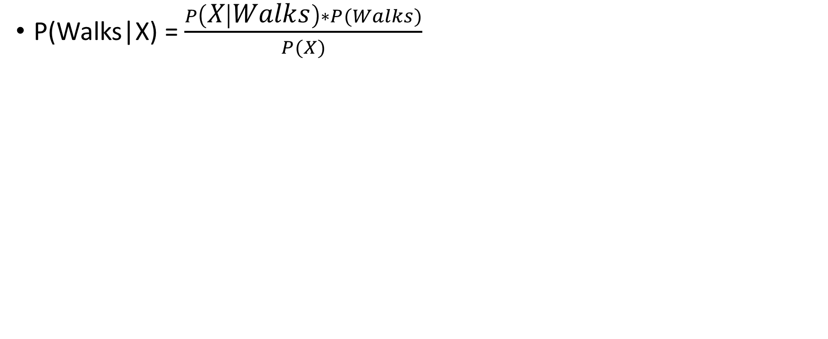
Step1

Slide 36
Step1
Prior Probability

Slide 37
Step1
Prior Probability
Marginal Likelihood

Slide 38
Step1
Likelihood
Prior Probability
Marginal Likelihood

Slide 39
Step1
Likelihood
Posterior Probability
Prior Probability
Marginal Likelihood

Slide 40
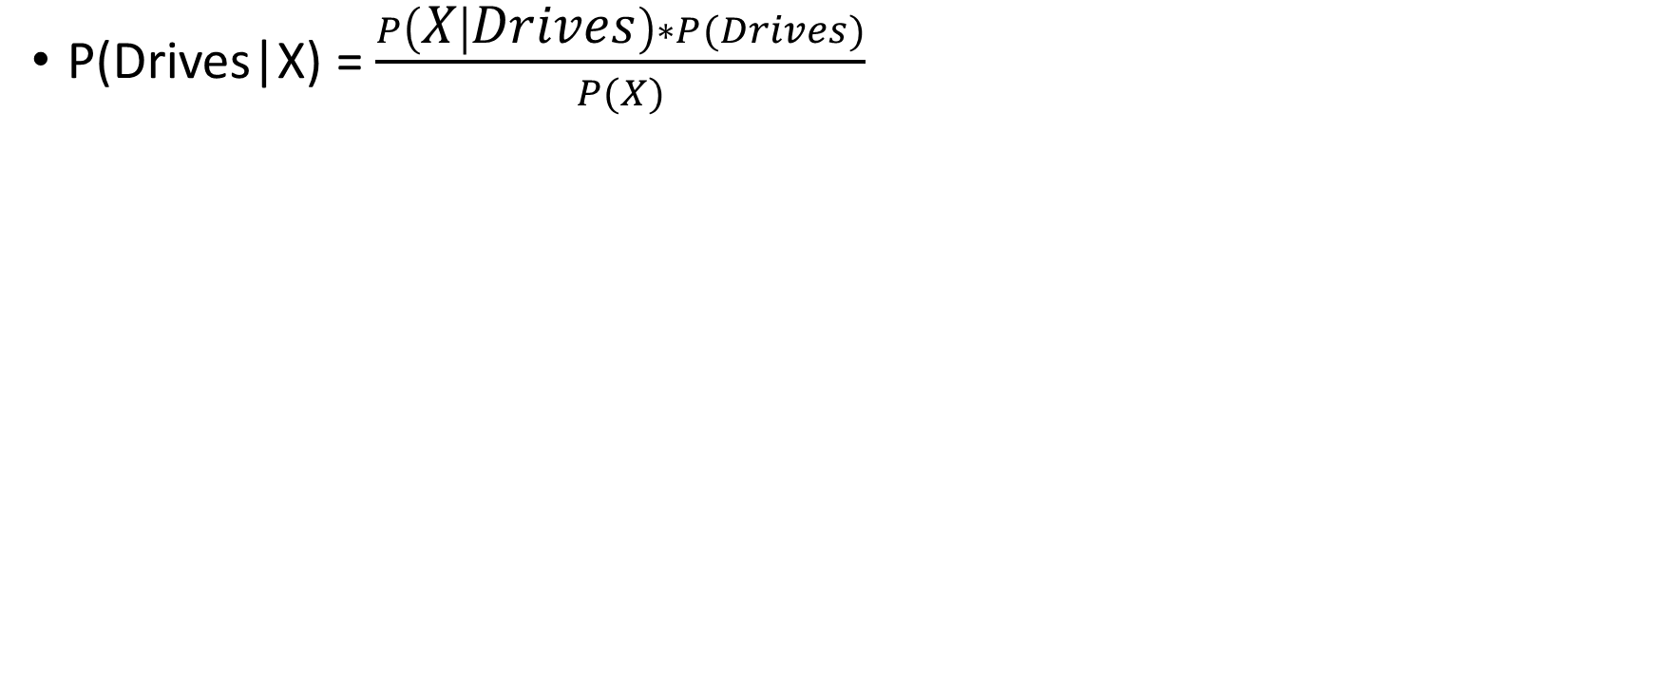
Step2
Likelihood
Posterior Probability
Prior Probability
Marginal Likelihood

Slide 41
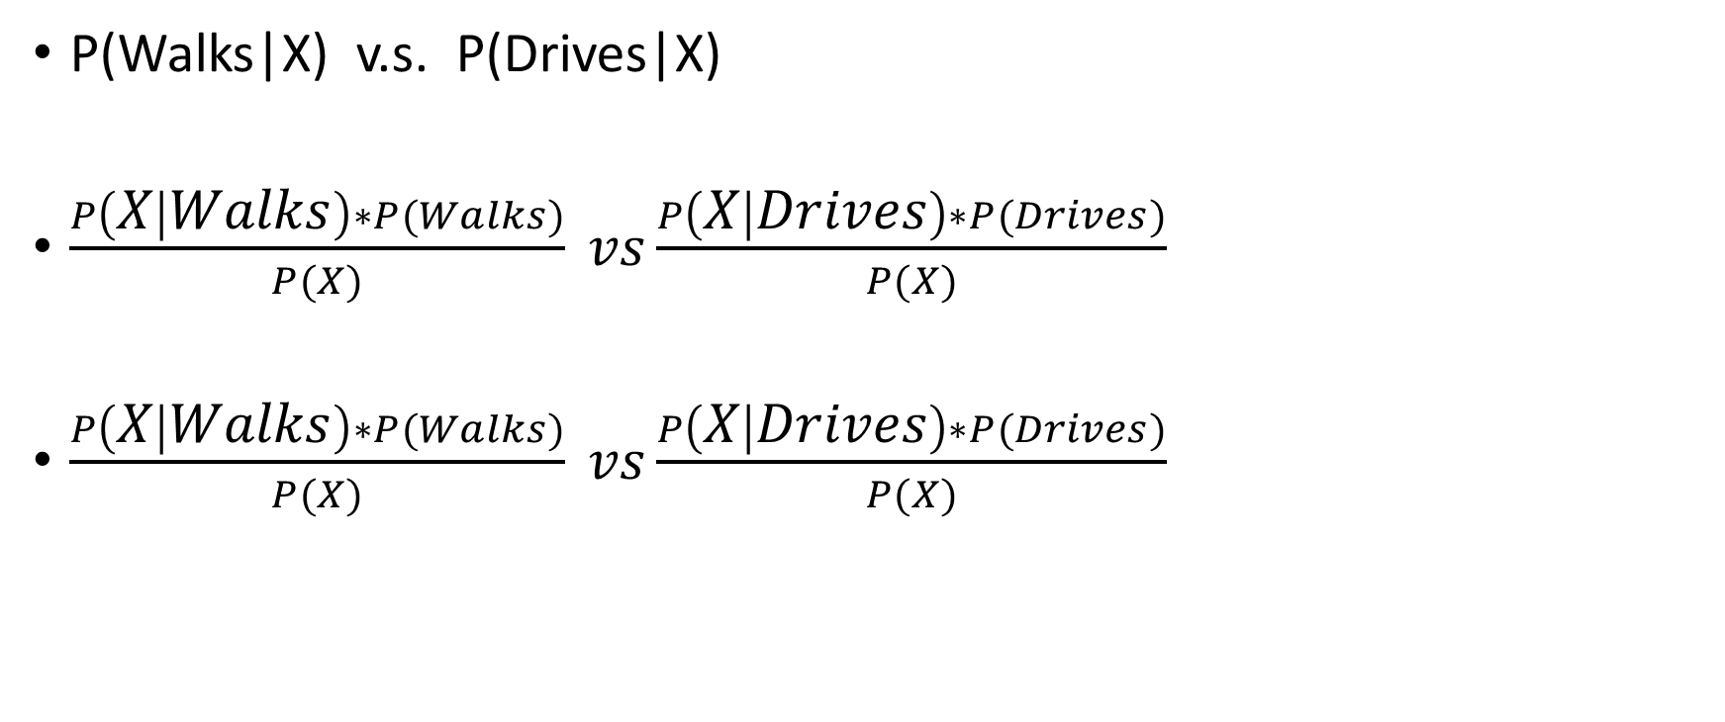
Step3

Slide 42
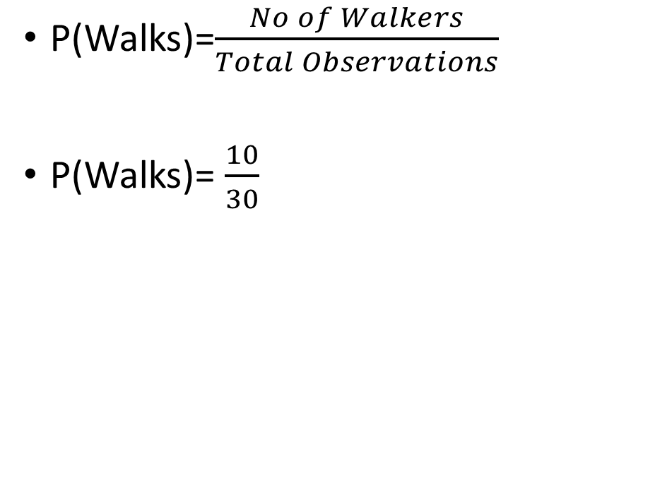
Naïve Bayes Classifier
Salary
Derives
New Data Point
Walks
Age

Slide 43
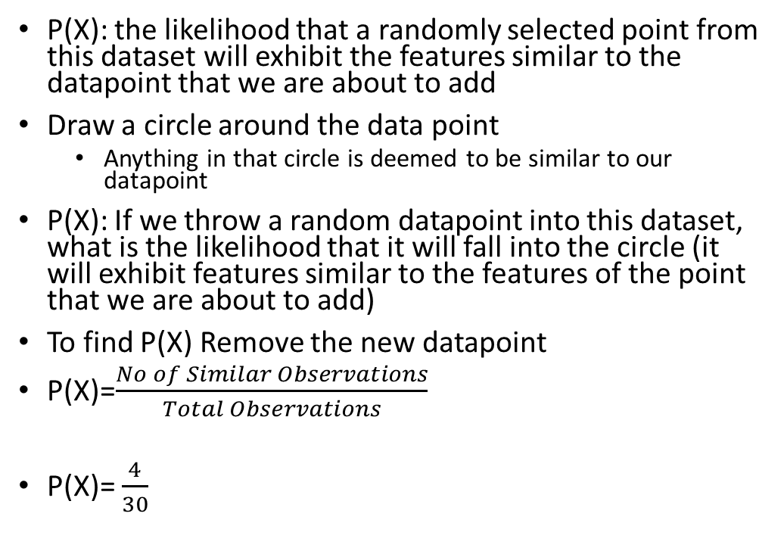
Naïve Bayes Classifier
Salary
Derives
New Data Point
Walks
Age

Slide 44
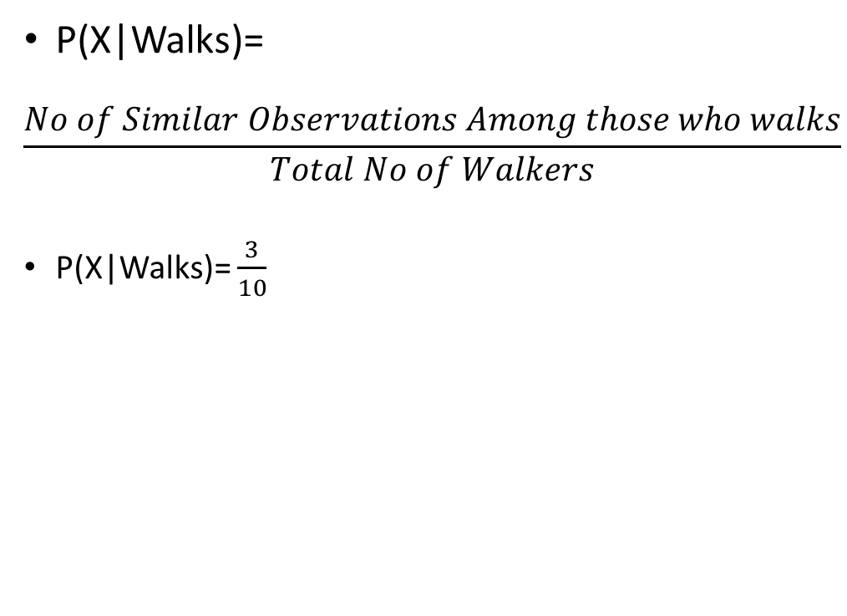
Naïve Bayes Classifier
Salary
Derives
New Data Point
Walks
Age

Slide 45
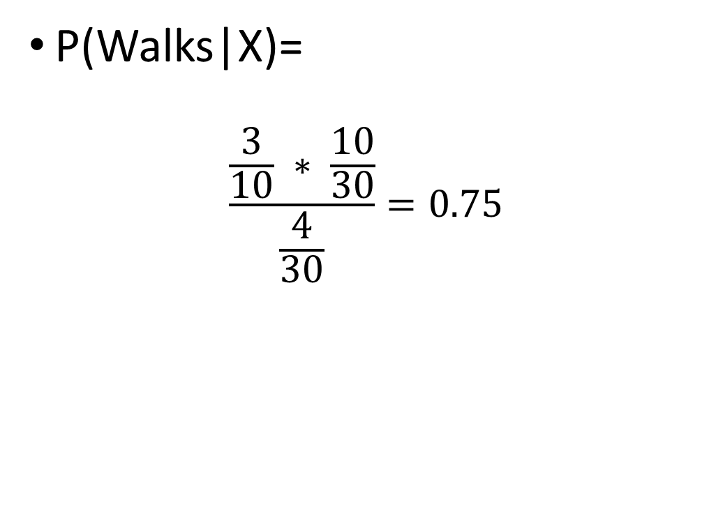
Naïve Bayes Classifier (Step 1)
Salary
Derives
New Data Point
Walks
Age

Slide 46
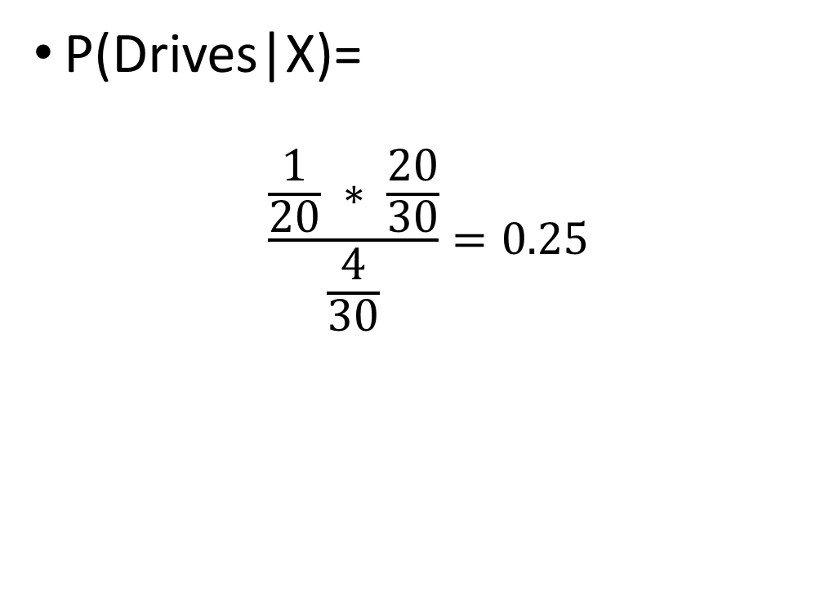
Naïve Bayes Classifier (Step 2)
Salary
Derives
New Data Point
Walks
Age

Slide 47
Naïve Bayes Classifier (Step 3)
P(Walks|X)> P(Drives|X)
Salary
Derives
New Data Point
Walks
Age

Slide 48
If more than two classes
In case of two classes
P(Walks|X) vs P(Drives|X)
We have calculate only one and check if its >.50
No need to calculate second one
In case if n classes
We need to calculate at least n-1 probabilities

Slide 49
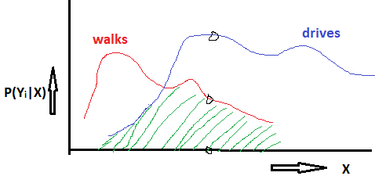
Bayes Minimum Error Classification
If(p(walks|X)>p(drives|X) => Xϵ walks
So we will decide Xϵ walks
But there is a finite probability that X ϵ drives
This is the probability of error.
i.e.
P(error|X)= min{p(walks|X), p(drives|X)}
As we are deciding based on minimizing the error it is known as
Total error of classification= the area under this curve= integration of min{p(walks|X), p(drives|X)} X from-∞ to +∞

Slide 50
Bayes Minimum Risk Classifier
More general than bayes minimum error classifier
ω_{i}: i=1…C (classes)
α_{j}: j=1…K (actions/predictions)
X- d-dimensional feature vector
Why is it more general
Because of introduction of loss function λ(α_{i}|ω_{j})
If we take an action α_{i} where the true class is ω_{j} then the Loss that we incur is λ(α_{i}| ω_{j})

Slide 51
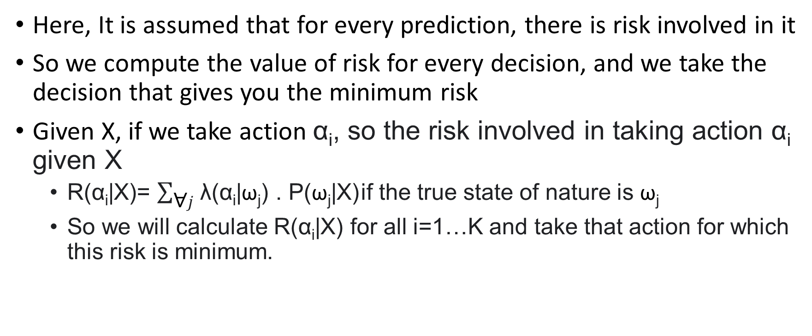
Bayes Minimum Risk Classifier

Slide 52
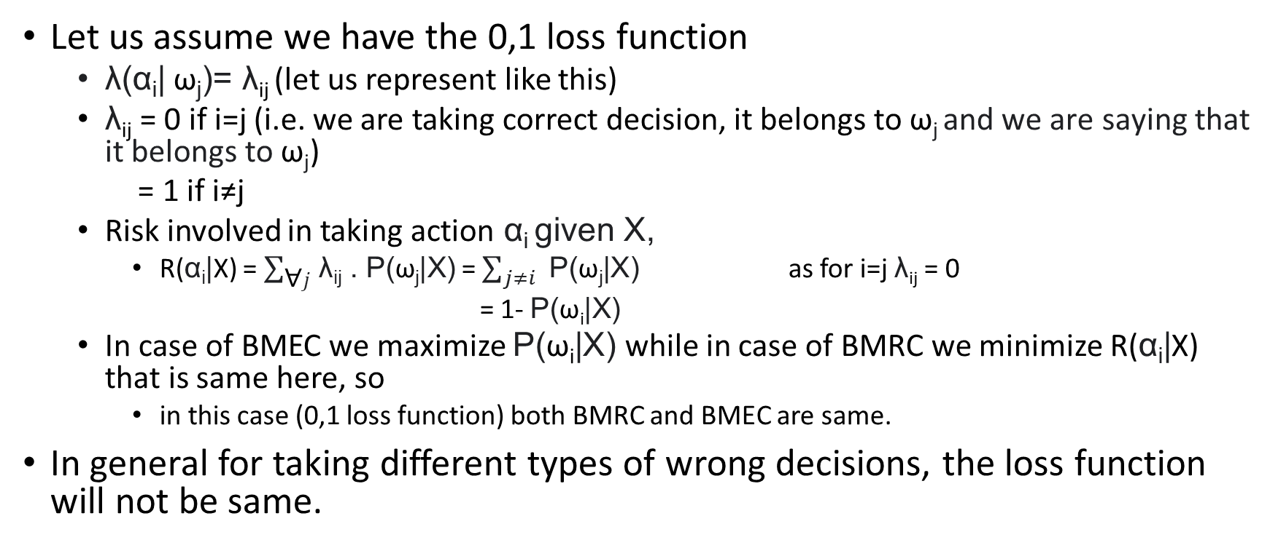
Relationship between BMRC and BMEC

Slide 53
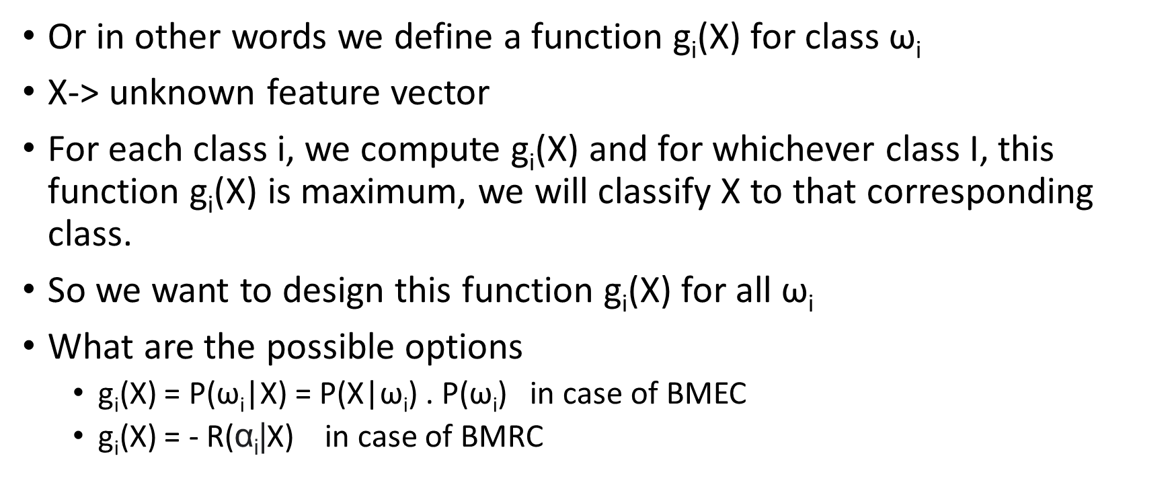
Discriminant function

Slide 54
we can also take any function of discriminant function that is monotonically increasing as a discriminant function.
We can take f: ln
So we can use g_{i}(x) = ln P(w_{i}|X) also as a discriminant function and the advantage is g_{i}(x)= ln P(w_{i}|X) = ln P(X|w_{i}) + ln P(w_{i}) addition is advantageous in computation.

Slide 55
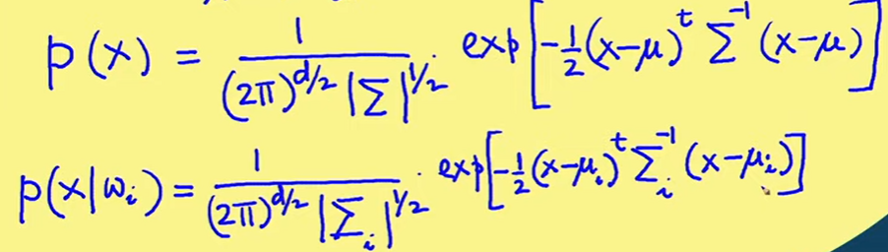
discriminant function under multivariate normal distribution
we are assuming our discriminant function as g_{i}(x)= ln P(w_{i}|X) + ln P(w_{i})
we can check what will be the form of discriminant function or decision boundary in case of a particular underlying distribution of data.
let us assume that our dataset X is of dimension d

Slide 56
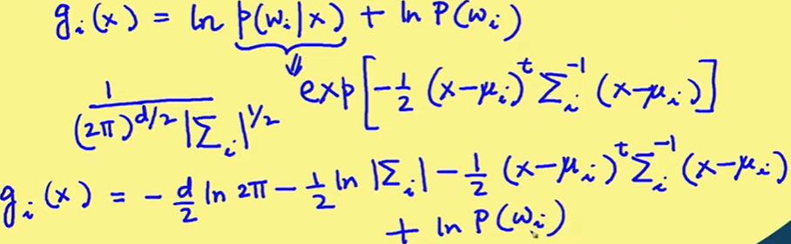
discriminant function under multivariate normal distribution
independent of class and thus does not differentiate among classes so we can ignore this term

Slide 57
discriminant function under multivariate normal distribution
We can have different cases
if all the components of the feature vector X are statistically independent (then covariance matrix will be diagonal matrix) and each component has the same variance σ² (then Σ=σ²工) and we are assuming this is same for all the classes (w_{i}) then Σ_{i}=σ²工, where 工 is unity matrix
Σ_{i}=Σ (when different components are not necessarily statistically independent, all components may also have different variance but the whatever is the covariance matrix it is same for all the classes (w_{i})
most general case- every class have its own covariance matrix
We will see the form of discriminant function in the first case

Slide 58
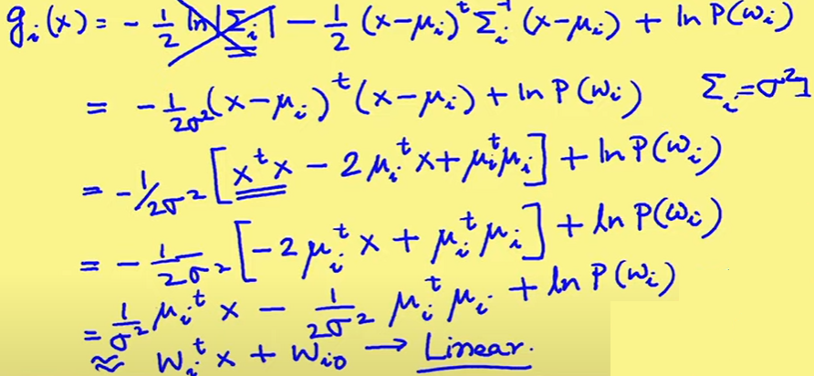
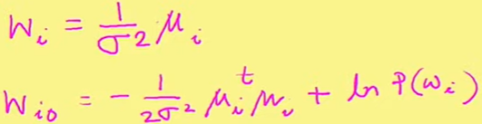
discriminant function under multivariate normal distribution
the form of discriminant function in the first case

Slide 59
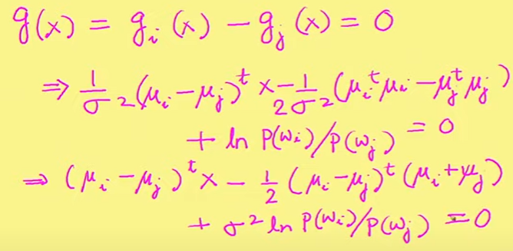
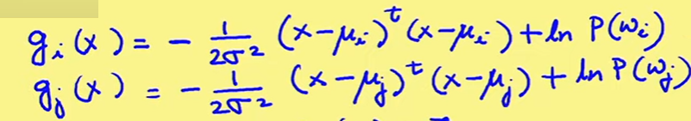
decision boundary under multivariate normal distribution
So now we can talk about the form of boundary that classify the two different classes
for boundary g(x), g_{i}(x) = g_{j}(x) as the discriminant functions values must be same at boundary so we can get the equation of boundary as
g(x) = g_{i}(x) - g_{j}(x) = 0

Slide 60
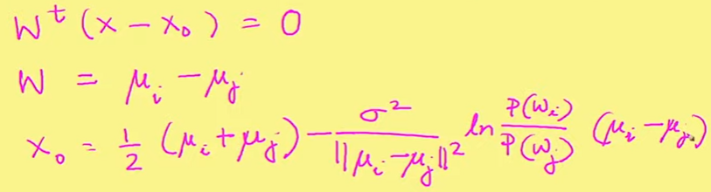
decision boundary under multivariate normal distribution
this expression can be written as:
So there is a linear boundary between ith and jth class
so in case of two dimension it is line,
in case of three dimension it is plane and
in case of multi-dimension it is hyper plane.

Slide 61
decision boundary under multivariate normal distribution
w is a vector drawn from μ_{i} to μ_{j} where μ_{i} is the mean of points in class w_{i} and μ_{j} is the mean of the points in class w_{j}
since decision surface is w^{T}(x- x_{o}) = 0, it is perpendicular (orthogonal) to the vector w so decision boundary is perpendicular to the line joining μ_{i} and μ_{j}
and it passes through the point x₀
if we take a case apriori prob p(w_{i}) = p(w_{j}) second term of the expression will become 0 and then x₀ is a point which at the middle of the line joining μ_{i} and μ_{j}
so in case of p(w_{i}) = p(w_{j}), the decision boundary will be an orthogonal bisector of the line joining μ_{i} and μ_{j}
so for determining the class of a new vector will be simply taking the distance of this vector with vector μ_{i} and μ_{j} and the mean vector which is closest to the new vector, it will belong to the corresponding class

Slide 62
decision boundary under multivariate normal distribution
in the case of p(w_{i}) > p(w_{j}) although the decision boundary will be orthogonal to the line joining μ_{i} and μ_{j} but it will be shifted towards μ_{j} indicating that more space is allocated to w_{i} so decision will be biased in favour of class w_{i}

Slide 63
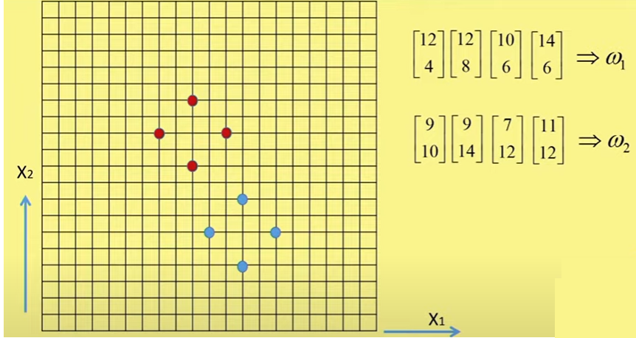
decision boundary under multivariate normal distribution
example

Slide 64
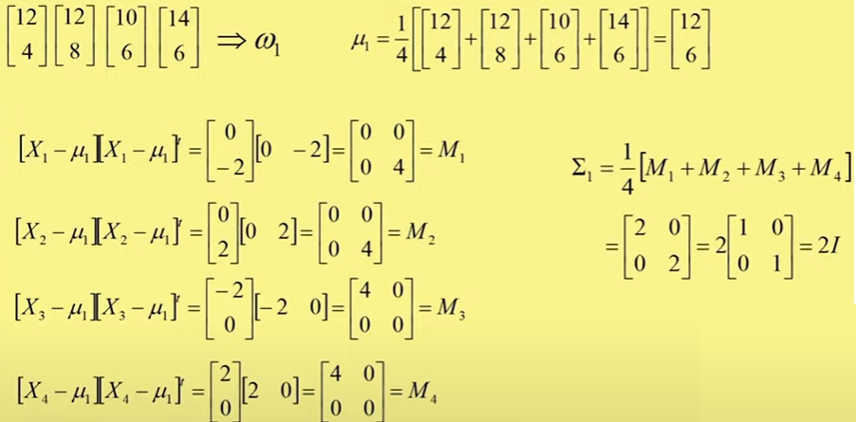
decision boundary under multivariate normal distribution

Slide 65
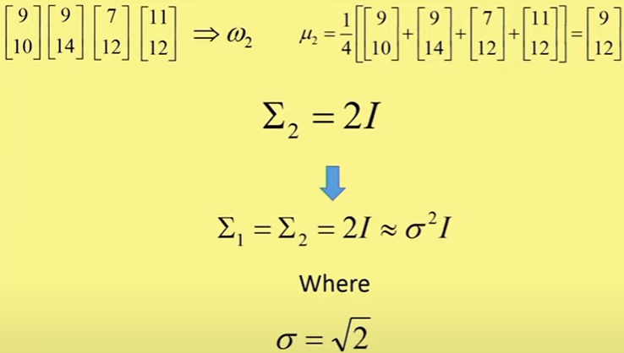
decision boundary under multivariate normal distribution

Slide 66
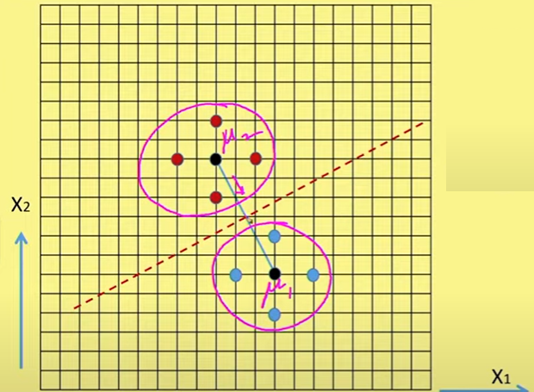
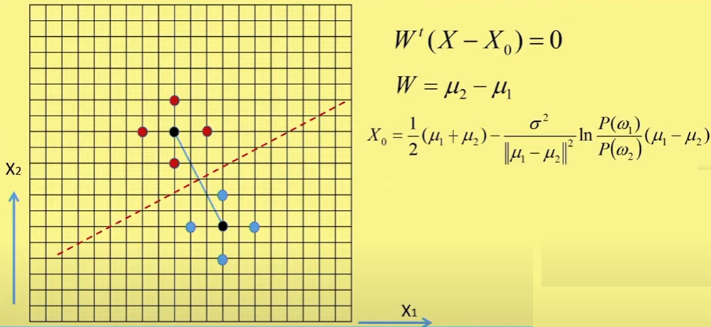
decision boundary under multivariate normal distribution
Classification rule in this case- minimum distance classification

Slide 67
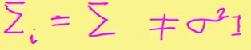
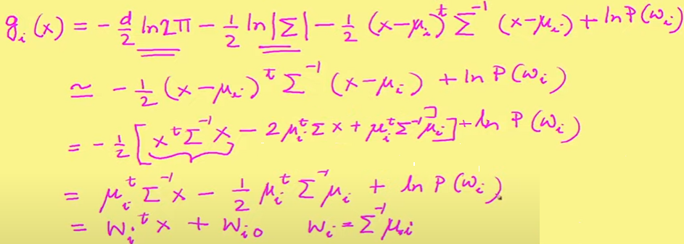
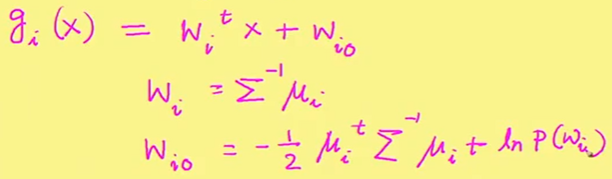
Discriminant function under multivariate normal distribution
Case 2-
we have seen earlier->
So in this case also the discriminant function is linear

Slide 68
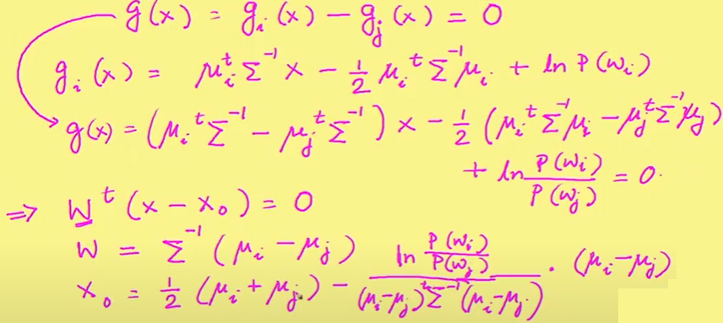
decision boundary under multivariate normal distribution

Slide 69
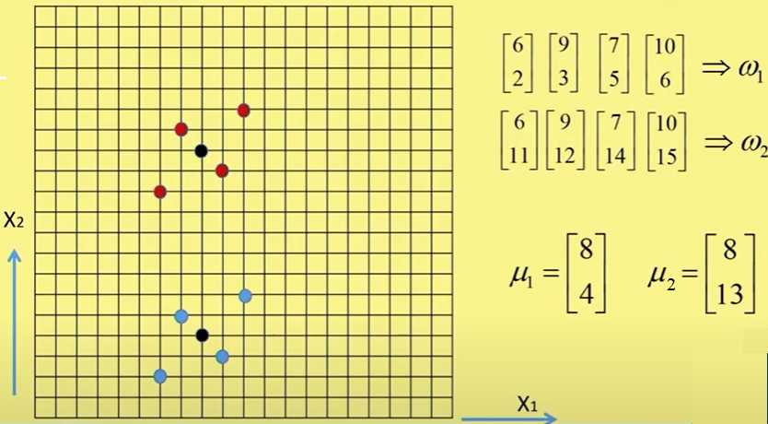
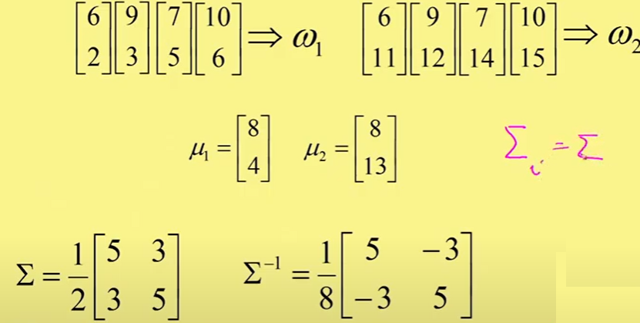
decision boundary under multivariate normal distribution

Slide 70
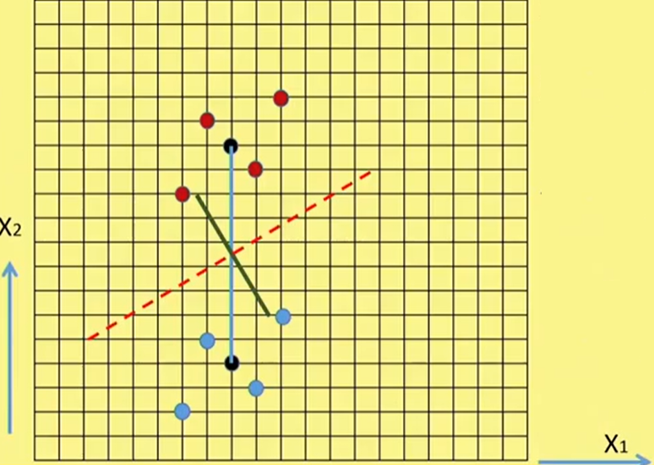
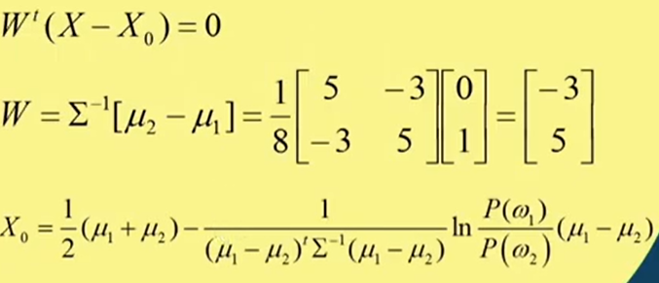
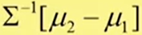
decision boundary under multivariate normal distribution
black points- μ1 and μ2
blue line- line joining μ1 and μ2
green line is
dotted line- orthogonal to green line and it passes through x₀ where x0 is half of μ1 and μ2 (in case of p(w1) = p(w2)

Slide 71
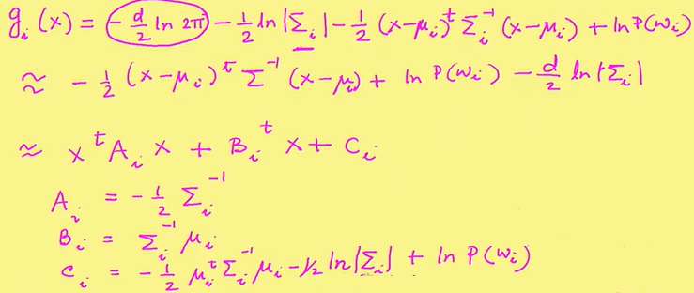
discriminant function under multivariate normal distribution
Case 3: most general case ∑_{i} is different for different classes.
so in this case discriminant function is non linear (quadratic function) because of quadratic terms x₁², x₂²,..x_{1.}x₂.x₂.x₃……

Slide 72
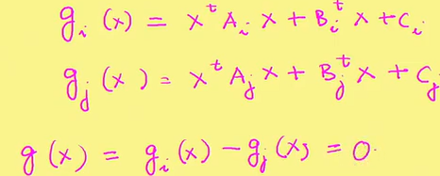
Decision boundary under multivariate normal distribution

Slide 73
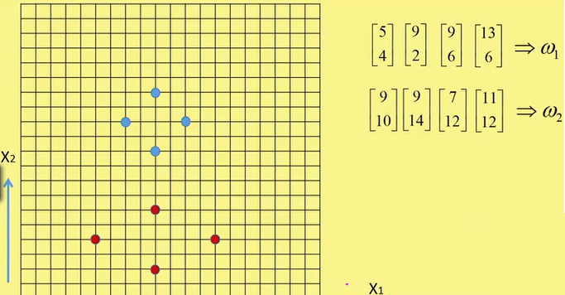
Decision boundary under multivariate normal distribution
example

Slide 74
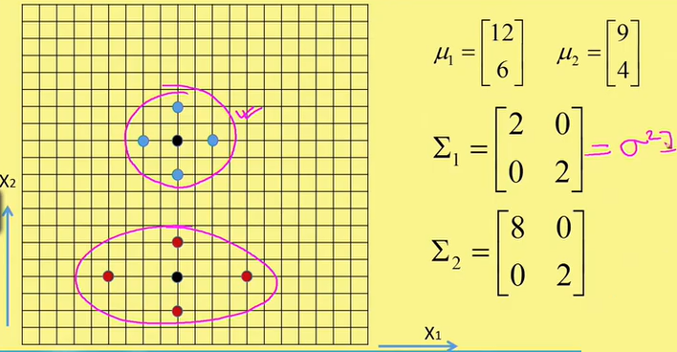
Discriminant Function under multivariate normal distribution
discriminant function for the first case will be linear
discriminant function for the second case will be quadratic

Slide 75
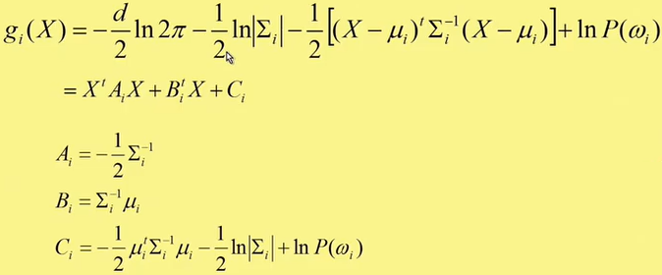
Decision surface under multivariate normal distribution

Slide 76
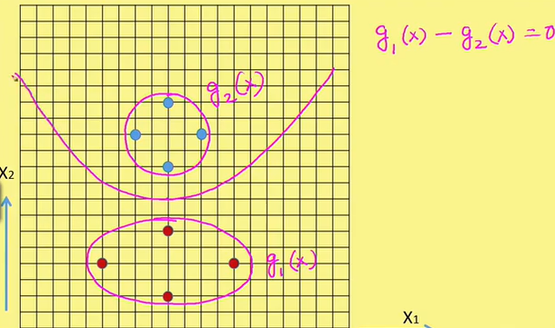
Decision surface under multivariate normal distribution

Slide 77
Applications and pros and cons
Naive Bayes algorithms are mostly used in
sentiment analysis, spam filtering, recommendation systems etc.
They are fast and easy to implement
But their biggest disadvantage is that the requirement of predictors to be independent
In most of the real life cases, the predictors are dependent, this hinders the performance of the classifier

Slide 78
Naive Bayes is an eager algorithm that learns a probabilistic model from the training data to make predictions.
During training phase it learns and calculate
the prior probability of each class label, which is the frequency of each class label in the training data.
Then, for each feature, Naive Bayes calculates the probability of that feature given each class label, which is known as the likelihood.

Slide 79
example: how Naive Bayes calculates the probability of a feature given each class label
Age | Income | Class
30 | 50,000 | Yes
25 | 70,000 | Yes
35 | 80,000 | Yes
45 | 60,000 | No
40 | 70,000 | No

Slide 80
To calculate the likelihood of a feature given a class label, Naive Bayes computes the frequency of each value of that feature for each class label.
For example, to calculate the likelihood of the "age" feature given the "Yes" class label, we count the number of times each age appears in the "Yes" class, and divide by the total number of instances in the "Yes" class.
We can then do the same for the "No" class.
In this example, we can see that all three instances in the "Yes" class have a different age value, so the frequency for each age is 1/3.
In the "No" class, there are two instances with age values of 40 and 45, respectively, so the frequency for each of these values is 1/2.

Slide 81
Age | Yes Count | Yes Freq | No Count | No Freq
25 | 1 | 1/3 | 0 | 0
30 | 1 | 1/3 | 0 | 0
35 | 1 | 1/3 | 0 | 0
40 | 0 | 0 | 1 | 1/2
45 | 0 | 0 | 1 | 1/2

Slide 82
We can then do the same calculation for the "income" feature given each class label, and obtain the likelihood probabilities for each feature and class label.
These likelihood probabilities can then be combined with the prior probabilities of each class to compute the posterior probabilities and make predictions for new instances.

Slide 83
Importing the libraries
import numpy as np
import matplotlib.pyplot as plt
import pandas as pd

Slide 84
Importing the dataset
dataset = pd.read_csv('Social_Network_Ads.csv’)
x = dataset.iloc[:, :-1].values
y = dataset.iloc[:, -1].values
Age EstimatedSalary Purchased
19 19000 0
35 20000 0
26 43000 0
27 57000 0
19 76000 0
27 58000 0
27 84000 0
32 150000 1
25 33000 0
Total- 1000 entries

Slide 85
Splitting the dataset into the Training set and Test set
from sklearn.model_selection import train_test_split
X_train, X_test, y_train, y_test = train_test_split(X, y, test_size = 0.25, random_state = 0)

Slide 86
Feature Scaling
from sklearn.preprocessing import StandardScaler
sc = StandardScaler()
X_train = sc.fit_transform(X_train)
X_test = sc.transform(X_test)

Slide 87
Training the Naive Bayes model on the Training set
from sklearn.naive_bayes import GaussianNB
classifier = GaussianNB()
classifier.fit(X_train, y_train)

Slide 88
Predicting the Test set results
y_pred = classifier.predict(X_test)
print(np.concatenate((y_pred.reshape(len(y_pred),1), y_test.reshape(len(y_test),1)),1))

Slide 89
Making the Confusion Matrix
from sklearn.metrics import confusion_matrix, accuracy_score
cm = confusion_matrix(y_test, y_pred)
print(cm)
accuracy_score(y_test, y_pred)
Output
[[63 3]
[ 7 25]]
0.9

Slide 90
Visualising the Training set results
from matplotlib.colors import ListedColormap
X_set, y_set = sc.inverse_transform(X_train), y_train
X1, X2 = np.meshgrid(np.arange(start = X_set[:, 0].min() - 10, stop = X_set[:, 0].max() + 10, step = 0.25),
np.arange(start = X_set[:, 1].min() - 1000, stop = X_set[:, 1].max() + 1000, step = 0.25))
plt.contourf(X1, X2, classifier.predict(sc.transform(np.array([X1.ravel(), X2.ravel()]).T)).reshape(X1.shape),
alpha = 0.75, cmap = ListedColormap(('red', 'green')))
plt.xlim(X1.min(), X1.max())
plt.ylim(X2.min(), X2.max())
for i, j in enumerate(np.unique(y_set)):
plt.scatter(X_set[y_set == j, 0], X_set[y_set == j, 1], c = ListedColormap(('red', 'green'))(i), label = j)
plt.title('Naive Bayes (Training set)')
plt.xlabel('Age')
plt.ylabel('Estimated Salary')
plt.legend()
plt.show()

Slide 91

Visualizing the Training set results

Slide 92
Visualizing the Test set results
from matplotlib.colors import ListedColormap
X_set, y_set = sc.inverse_transform(X_test), y_test
X1, X2 = np.meshgrid(np.arange(start = X_set[:, 0].min() - 10, stop = X_set[:, 0].max() + 10, step = 0.25),
np.arange(start = X_set[:, 1].min() - 1000, stop = X_set[:, 1].max() + 1000, step = 0.25))
plt.contourf(X1, X2, classifier.predict(sc.transform(np.array([X1.ravel(), X2.ravel()]).T)).reshape(X1.shape),
alpha = 0.75, cmap = ListedColormap(('red', 'green')))
plt.xlim(X1.min(), X1.max())
plt.ylim(X2.min(), X2.max())
for i, j in enumerate(np.unique(y_set)):
plt.scatter(X_set[y_set == j, 0], X_set[y_set == j, 1], c = ListedColormap(('red', 'green'))(i), label = j)
plt.title('Naive Bayes (Test set)')
plt.xlabel('Age')
plt.ylabel('Estimated Salary')
plt.legend()
plt.show()

Slide 93

Visualising the Test set results

